Slide 1
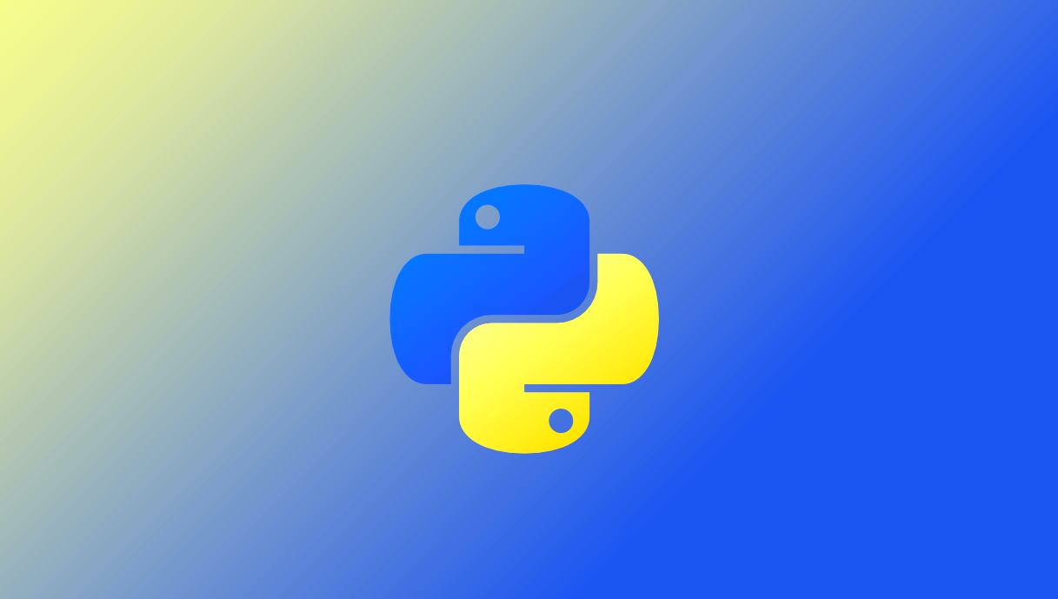
Data Analysis with Python

Slide 2

1.1 Intro to Python
What is python?
Python is an interpreted, high-level and general-purpose programming language. Python's design philosophy emphasizes code readability with its notable use of significant indentation.
What can python do?
Software and web application development
Data processing, scientific computing
Machine learning, artificial intelligence
System scripting, robotic processing
…
Why python?
Python is easy to use, powerful, and versatile, making it a great choice for beginners and experts alike. Python's readability makes it a great first programming language.
Notes:
Python can be used to build server-side web applications, whereby creating, deploying and operating web applications and application programming interfaces for the Web is more efficient with the use of existing open-source libraries to speed up the process of a working application.

Slide 3
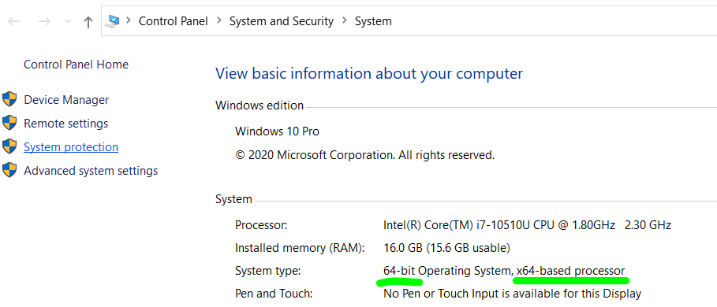
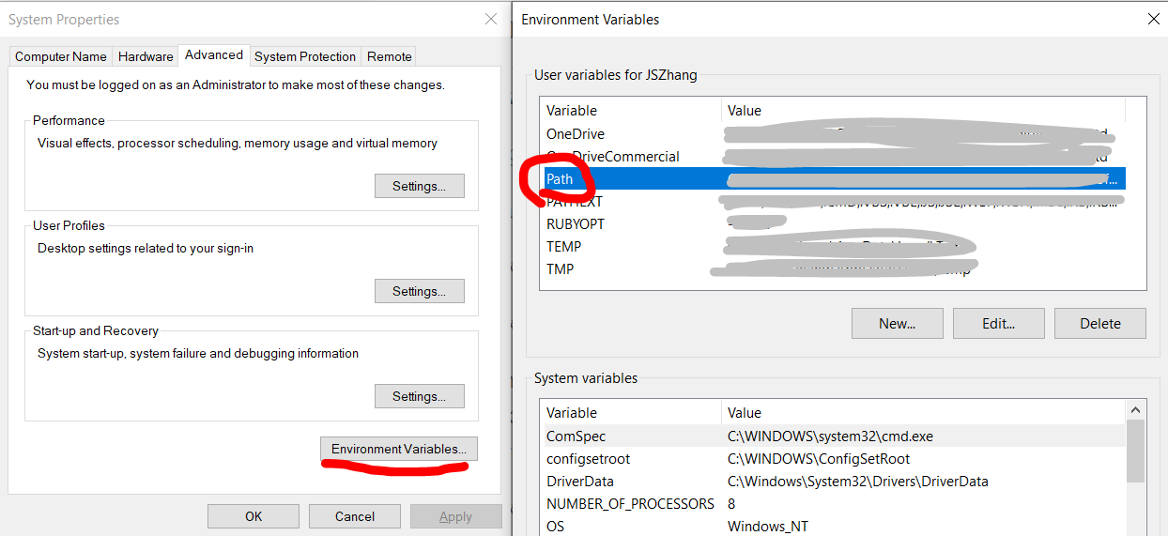
1.2 Install Python on Windows
Windows
Download Python installer from website (https://www.python.org/downloads/windows/ ) based on your Windows version (32-bit or 64-bit).
Run the downloaded installer program, remember to select Add Python 3.x to PATH before clicking Install Now
To run Python3 REPL (interactive program, REPL stands for Read-Evaluate-Print-Loop), type python in Command Prompt.
Windows
If you see error message 'python' is not recognized as an internal or external command,
then add the path to python.exe to environment variables

Slide 4
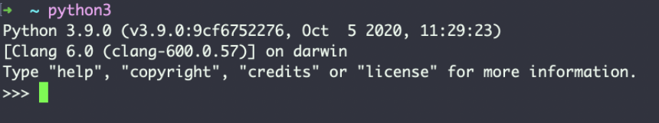
1.2 Install Python on MacOS
Method 1:
Download Python installer from website (https://www.python.org/downloads/mac-osx/ ).
Method 2:
Run command brew install python3 if Homebrew is installed
To run Python3 REPL, type python3 in Terminal application.
Notes:
https://docs.python-guide.org/starting/install3/osx/
https://flaviocopes.com/python-installation-macos/

Slide 5
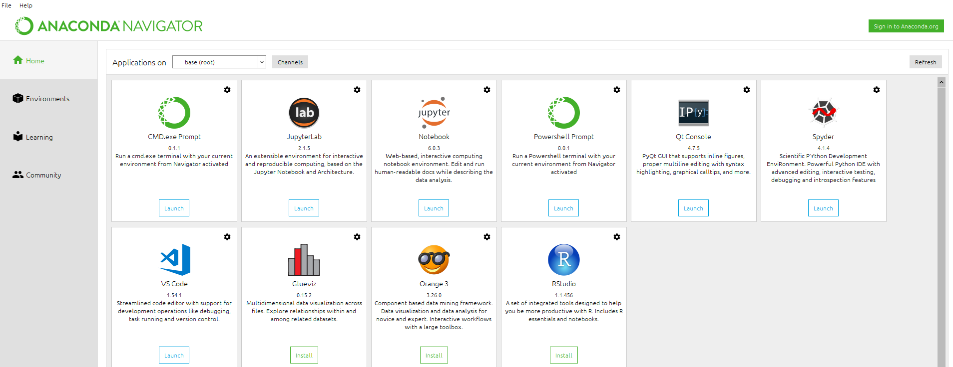
1.3 Install Jupyter Notebook via Anaconda
Anaconda
Anaconda is a free and open-source distribution of the Python programming languages for scientific computing that aims to simplify package management and deployment. Visit http://anaconda.com/downloads to download and install Anaconda
It provides different interface (Jupyter, Spyder) to execute python functions.
Python automatically comes with Anaconda; hence users only need to install Anaconda.
Python and pip (Python package manager) are included in Anaconda. After installation, the default python path is modified by Anaconda
Jupyter Notebook App
It is a server-client application that allows editing and running notebook documents via a web browser.
Spyder
Spyder is an open-source cross-platform integrated development environment (IDE) for scientific programming in the Python language.

Slide 6
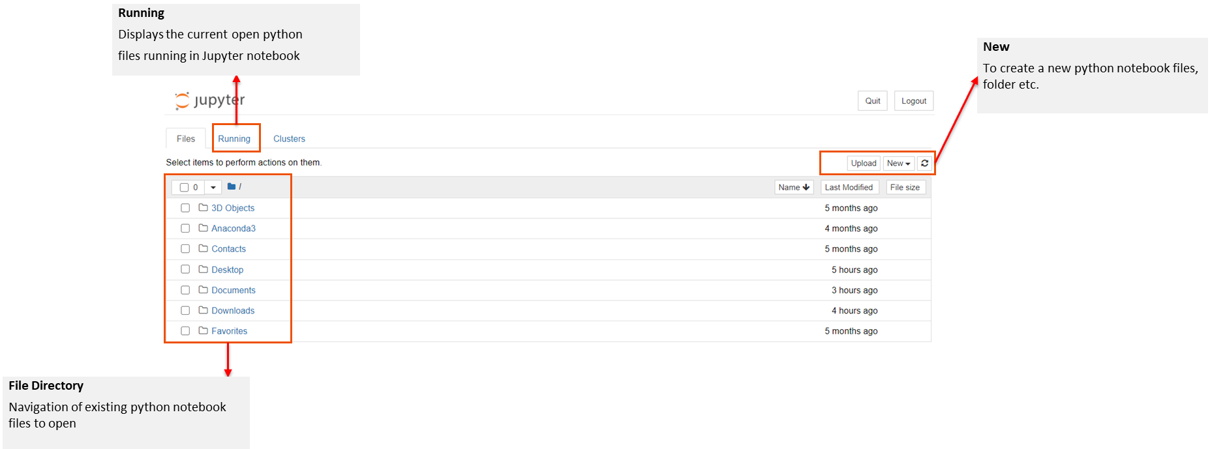
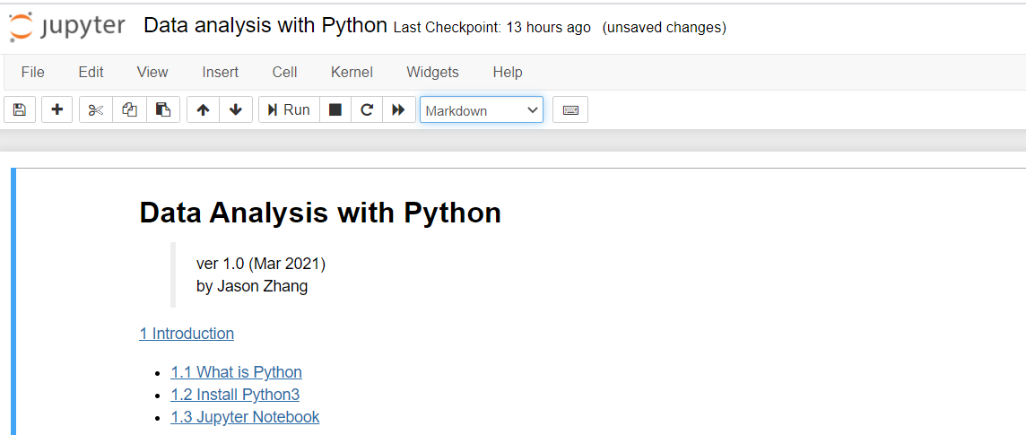
1.4 Jupyter Notebook Interface
Jupyter notebook opens to the default file directory (C: drive).
Open existing files by navigating to the appropriate directory or create a new python file using the “New” button in the top right corner.
Toolbar
Allows users to run, add another section of code, or change the code format.
Input/Output
User input of code or markdown and the result of output
Notes:
Jupyter notebook, used a lot in data analysis. Our course will be mainly based on jupyter notebook.
Go to anaconda, and click the jupyter notebook
Data analysis with python jupyter notebook walk through

Slide 7

1.5 Jupyter Notebook Interface
Jupyter Notebook Shortcuts
Edit mode: text area is focused; left border is green.
Command mode: text area is out of focus, left border is blue.
Press Esc to exit Edit mode and enter Command mode . Use up/down arrow keys to select different lines.
Command Mode (press Esc to enable)
F: find and replace
Ctrl-Shift-F: open the command palette
Ctrl-Shift-P: open the command palette
Enter: enter edit mode
P: open the command palette
Shift-Enter: run cell, select below
Ctrl-Enter: run selected cells
Alt-Enter: run cell and insert below
Y: change cell to code
M: change cell to markdown
R: change cell to raw
1: change cell to heading 1
2: change cell to heading 2
3: change cell to heading 3
4: change cell to heading 4
5: change cell to heading 5
6: change cell to heading 6
K: select cell above
Up: select cell above
Down: select cell below
J: select cell below
Shift-K: extend selected cells above
Shift-Up: extend selected cells above
Shift-Down: extend selected cells below
Shift-J: extend selected cells below
A: insert cell above
B: insert cell below
X: cut selected cells
C: copy selected cells
Shift-V: paste cells above
V: paste cells below
Z: undo cell deletion
D,D: delete selected cells
Shift-M: merge selected cells, or current cell with cell below if only one cell is selected
Ctrl-S: Save and Checkpoint
S: Save and Checkpoint
L: toggle line numbers
O: toggle output of selected cells
Shift-O: toggle output scrolling of selected cells
H: show keyboard shortcuts
I,I: interrupt the kernel
0,0: restart the kernel (with dialog)
Esc: close the pager
Q: close the pager
Shift-L: toggles line numbers in all cells, and persist the setting
Shift-Space: scroll notebook up
Space: scroll notebook down

Slide 8



2.1 Print
In Python3, `print` is a function.
A function can be invoked by specifying the function name, followed by arguments enclosed by a pair of parentheses.
We will look at more about functions later.
If no argument is given, `print` will output an empty line.
The print function outputs 2 parameters:
string "1 + 2 ="
the evaluated value of expression 1 + 2, which is 3

Slide 9
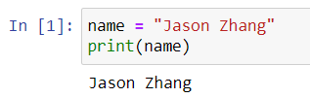
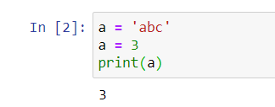
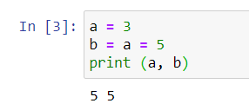
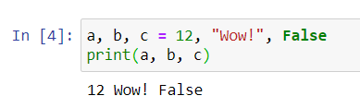
2.2 Variables
1. Definition
We will discuss what is variable. Variable is a core concept in programming. We use it variables to store data in computer memory.
We can imagine there is a lookup table in computer.
Variable is also called Identifier, which is a name referring to a value or values stored in the memory of the computer.
We can imagine there is a look-up table stored inside the computer, every time we define a variable, Python inserts one key-value pair into that table, where key is our variable name, and value is simply the value that the variable name referring to.
We created a variable called name and assigned the value "Jason Zhang" to it.
The first line of the program is called an assignment statement.
name ← “Jason Zhang”
2. Key – value
Illustrate the name, value, and assignment statement using equal signs.
= is not the same as ==
Variables' values can be changed (re-assigned).
Variable a is defined with an initial value 'abc’. Then a new value 3 is assigned to the variable a, thus the value of a is 3 at the final state.
Assignment statement is evaluated from right to left.
The expression on the right-hand-side of = is evaluated first, then assigned to the variable name on the left-hand-side of =.
3. Examples
You can assign values to multiple variables within one assignment statement

Slide 10
2.2 Variables – code challenge
Q: Write a program to swap two variables.

Slide 11
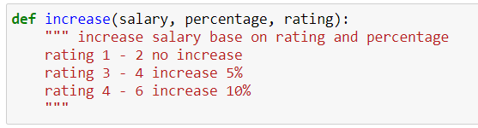
2.3 Comments
Annotates the code to help the programmer understands the intended logic.
These comments are ignored by the interpreter. A comment line starts with #.
Try to add some meaningful comments for reference, not only for you, but also someone who may read your code.
Notes:
https://realpython.com/python-comments-guide/

Slide 12
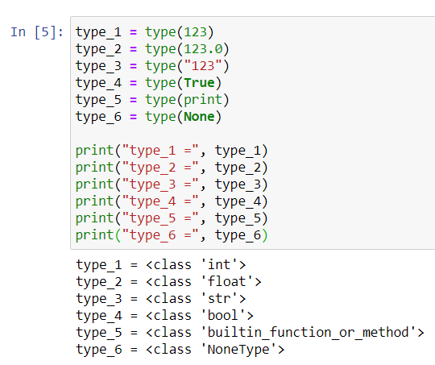
2.4 Data Types
Data Types | Description | Example
String (str) | A string form, usually printed with inverted commas, applicable to all words including numbers | “a”, “good”, “TRUE”, “23.4”, “2”
Integer (int) | A number that is usable with all aggregate and non- aggregated math functions | 1, 2, 3
Float (float) | Like numeric, except it has decimal place, i.e., not a whole number | 1.23, 3.5
Logical (bool) | A Boolean expression, defining true or false | True, False (Note: this is case-sensitive, hence it must be typed exactly as this example)
None (None) | None stands for an empty value | None
Use type() to get the data type of a specific value or a variable.

Slide 13

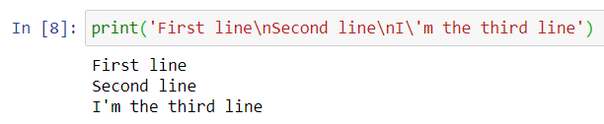
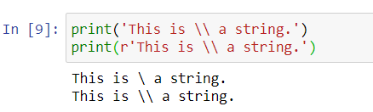
2.4 Data Types
Integers (int)
Python can deal with any integer values, including negative integers, such as 0, -99, 12345
Floating Point Number (float)
A floating-point number is a number that has a fractional part.
It is called floating point number because the position of the decimal point can be changed in the scientific notation.
For example, 3.1415e9 is the same as 314.15e7.
String (str)
A string is a text surrounded by a pair of single quotes ' or double quotes ", for example 'This is a string.', "This is another string.".
The first and last quotation marks should be matched, and they are not parts of the string.
Use escape character (\) to output new line \n, tab \t, back slash \\, single quote \', double quote \" etc. inside a string.

Slide 14
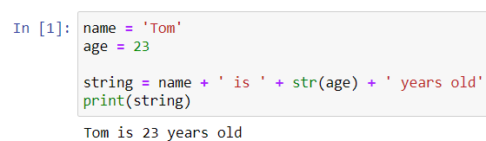
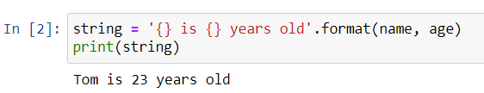

2.5 String Formatting
During programming, we are required to form strings containing variables frequently.
We can do this with concatenation using + operator.
Note:
A string cannot concatenate with a non-string data type; thus we must cast non-string values using str function.
We need to add leading or trailing spaces to some strings in order to make sure words are separated by spaces properly.
In Python, each string has a format function. format_string.format(arguments).
Note:
{} represents a variable in the format string.
We can re-arrange the order by specifying the index number in the braces, for example {2}.
We can apply padding, aligning and truncating to formatting numbers.
Note:
Use letter f represent floating point numbers.
We add a number after . to limit the number of digits after the decimal point

Slide 15
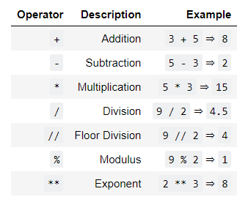
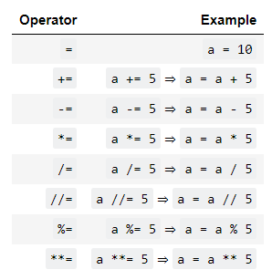
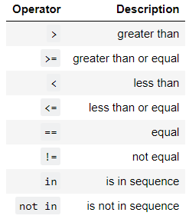
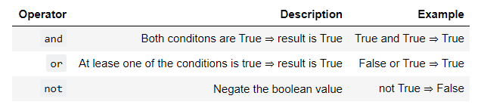
2.6 Operators
Basic Operators
Assignment Operators
Logical Operators
* A sequence can be a list, tuple etc.
Boolean Operators

Slide 16
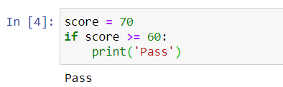
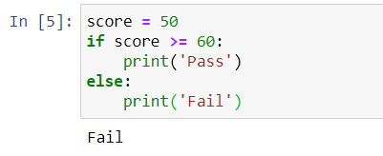
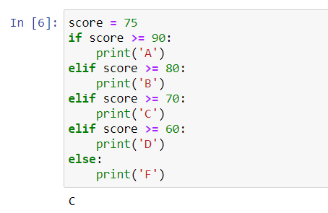
2.7 Control flow – if statement
if/elif/else Statement
condition
if condition is false
else code
if condition is true
If code
elif condition is true
elif code
Note:
Be careful to the indentation. Usually, we use 4-space or Tab indentation.
Don't miss the colon :

Slide 17
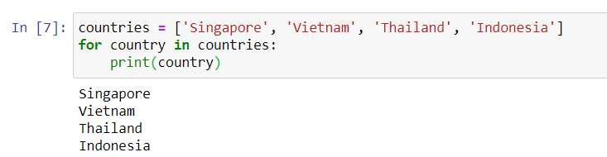
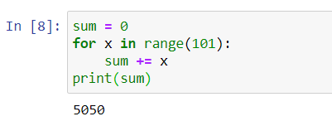
2.7 Control flow – for loop
for loop
all iterables are completed
Statement 1
Statement 2
etc …
iterables
continue to next iterable

Slide 18
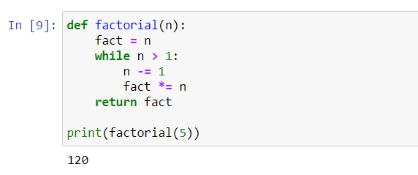
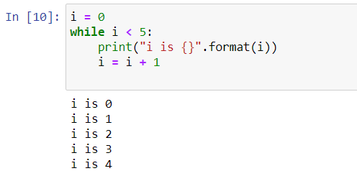
2.7 Control flow – while loop
while loop
False
Statement 1
Statement 2
Condition Update
condition
True
Note:
Be careful of infinite loops.

Slide 19
2.7 Control flow – code challenge
Q: Write a program to get sum of all the odd numbers within 1000 using loops in three ways.

Slide 20
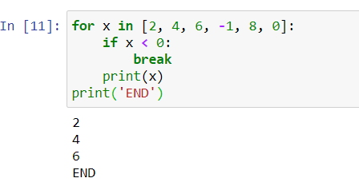
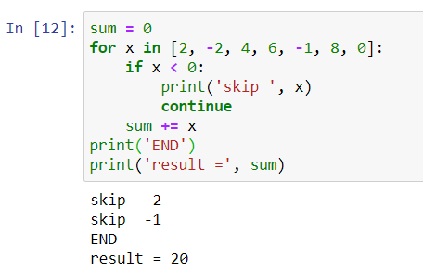
2.7 Control flow – break/continue
break
continue
use break statement to exit a loop.
use continue to skip current iteration and continue with the next one.

Slide 21
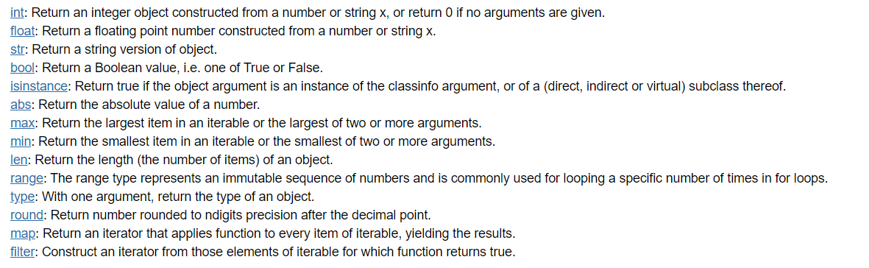





2.8 Built-in Functions
Some commonly used built-in functions
Type conversion

Slide 22
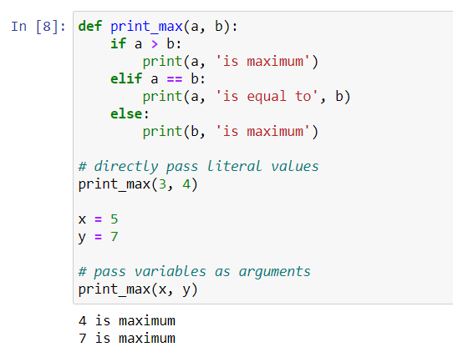
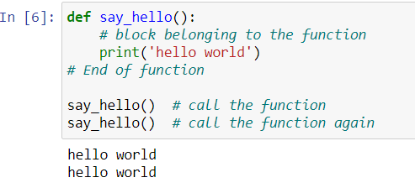
2.9 Functions
Functions are reusable pieces of programs.
A function can take parameters, which are values you supply to the function so that the function can do something utilising those values.

Slide 23
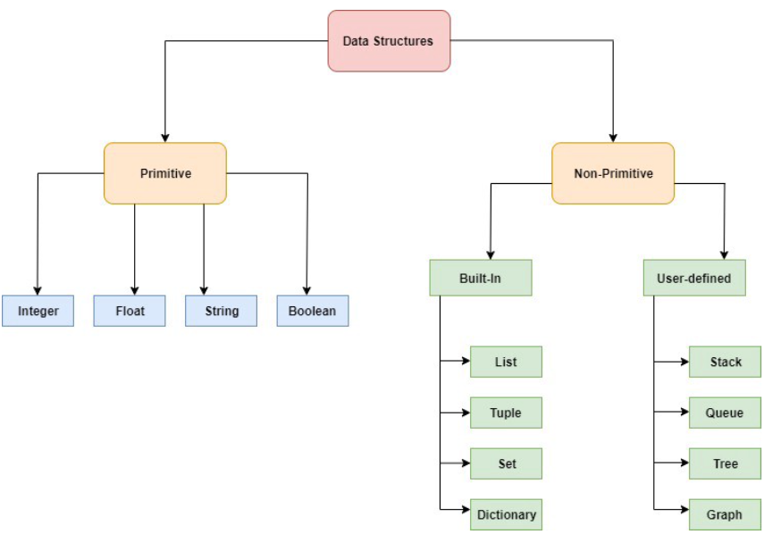
3.1 Data structure
Data structures provide us with a specific and way of storing and organizing data such that they can be easily accessed and worked with efficiently.
Notes:
https://python.swaroopch.com/data_structures.html

Slide 24
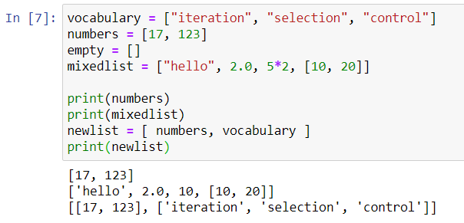

3.2 List
A list is a sequential collection of Python data values, where each value is identified by an index.
The values that make up a list are called its elements.
Lists are like strings, which are ordered collections of characters, except that the elements of a list can have any type and for any one list, the items can be of different types.
The variable vocabulary is a list.
You can get the number of items in it by using len()

Slide 25
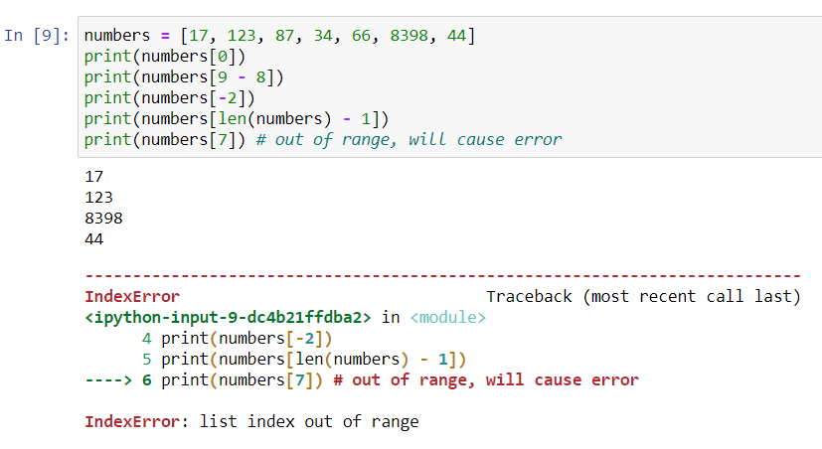

3.3 Access list element
A list index starts from zero.
We can get the index number of the last element in a list by calculating len(list) - 1. or
we can use -1 to get the last index directly

Slide 26
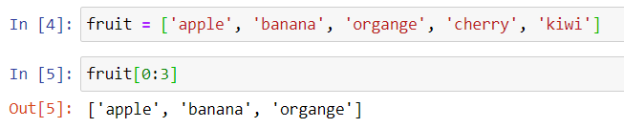
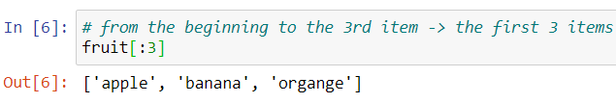

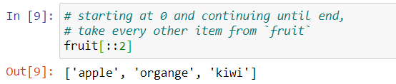
3.4 List slicing
It is a common operation to get a part of a list. For instance, to get the first 3 items in the following list.
Note:
fruit[0:3] means getting the items from index 0 to index 3, but 3 is not included. Thus, the result is equivalent to [ fruit[0], fruit[1], fruit[2] ]
Note:
We can omit the starting index if it is 0.
Note:
Since fruit[-2] represent the second last item, we can apply the same idea in slicing.
Note:
If the ending index is not included, slicing will get until the end of the list. Remember that -1 index represents the last item.
If there is a number after two colons :, it represents steps.

Slide 27
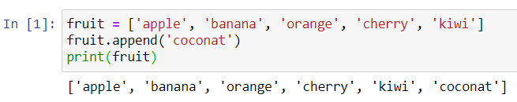
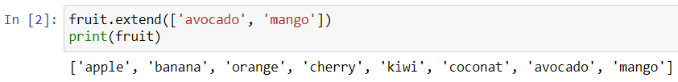
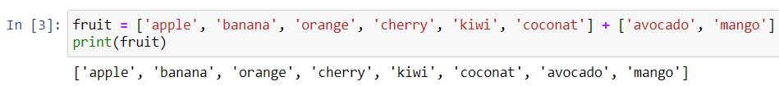
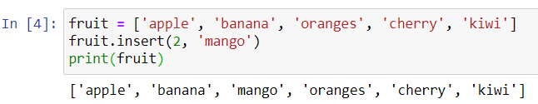
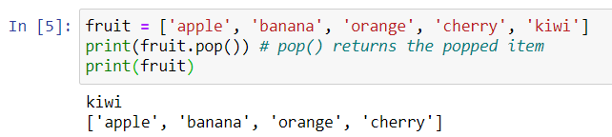
3.5 List method
list is a mutable sequence, which means you can add items to it, or remove items from it
append(): To add one more item to the end of the list
extend()
insert(): Insert an item to a specific position in the list
pop(): Remove the last item
Notes:
https://docs.python.org/3/tutorial/datastructures.html

Slide 28
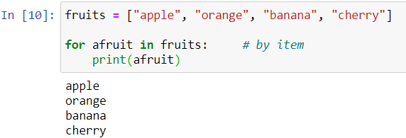
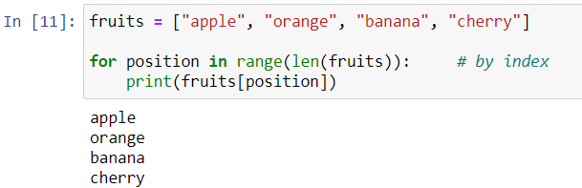
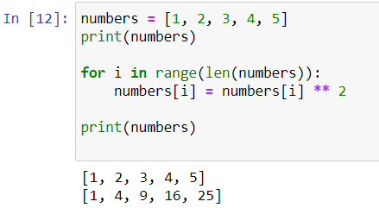
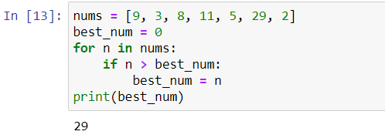
3.6 List & loops
Traverse the list using iteration by item
Traverse the list using iteration by index
Since lists are mutable, it is often desirable to traverse a list, modifying each of its elements as you go.
The following code squares the numbers from 1 to 5
The following code gets the maximum value from a list of integers.
Notes:
https://docs.python.org/3/tutorial/datastructures.html

Slide 29
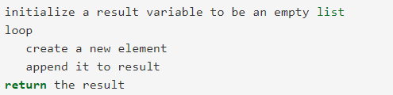
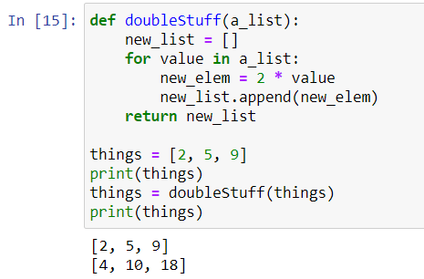
3.7 Generate a List
Whenever you need to write a function that creates and returns a list, the pattern is usually:
Initialize the result variable to be an empty list
Loop
Append it to the result
Notes:
https://docs.python.org/3/tutorial/datastructures.html

Slide 30
3.8 Generate a List – Code challenge
Q: Write a program to generate the first 100 prime numbers. The input is the number of prime numbers, the output is a list of prime numbers.
Notes:
https://docs.python.org/3/tutorial/datastructures.html

Slide 31




3.9 tuple
tuple is very similar to list except that tuple is immutable, which means you cannot modify a tuple.
Instead of using square brackets [] as in a list, we use parentheses () to represent tuples.
Once a tuple is initialized, elements cannot be changed, thus methods like append() or insert() are not applicable to tuples.
But you can do indexing, slicing on tuples just like lists.
Functions can return tuples as return values. This can be very useful.
We often want to know some batsman’s highest and lowest score, or we want to find the mean and the standard deviation, or we want to know the year, the month, and the day.
In each case, a function (which can only return a single value), can create a single tuple holding multiple elements.

Slide 32



3.10 Dictionary
Dictionaries are Python’s built-in mapping type. A map is an unordered, associative collection. The association, or mapping, is from a key, which can be any immutable type, to a value, which can be any Python data object.
Dictionary is mutable.
The dictionary is denoted {key: value,…}. Empty dictionary can be denoted {}
It is efficient to look up values by keys.
Add new key-value pairs into a dict.
Assign value to an existing key replaces old one

Slide 33




3.11 Dictionary method
keys(): Return the keys in the dict.
values(): Return the values in the dict.
items(): Returns a view of the key-value pairs as tuples in the dict.
get(): Return the value associated with key; None otherwise

Slide 34
3.12 Dictionary – Code challenge
Q: Write a program called alice_words.py that creates a text file named alice_words.txt containing an alphabetical listing of all the words, and the number of times each occurs, in the text version of Alice’s Adventures in Wonderland. (You can obtain a free plain text version of the book, along with many others, from http://www.gutenberg.org.) The first 10 lines of your output file should look something like this
Word | Count
a | 631
a-piece | 1
abide | 1
able | 1
about | 94
above | 3

Slide 35


3.13 Set
set is like a dict without values. Since keys are always unique, there is no duplicate in a set.
You can also construct a set by passing a list to the set() function.

Slide 36




3.14 Set method
add(): Add an element to the set.
remove(): Remove a specified element.
difference(): Returns a set containing the difference between sets.
update(): updates the current set by adding items from another set.

Slide 37

4.1 Python Package
It makes a Python program unmaintainable if there are too many variables and functions in a single file.
Through grouping functions into different modules, each file can have fewer codes.
In Python, each .py file can be regarded as a module
In order to prevent conflicts between modules, Python provides package to organize modules.
There are two modules, and both are called mod, but if they are in different packages, packageone and packagetwo, then it is totally fine.
They can be identified as packageone.mod and packagetwo.mod
Notes:
https://docs.python.org/3/tutorial/modules.html

Slide 38





4.2 Install and Import from package
Install a package using pip
Import a package
Use the syntax “pip install <package>” in the command lines
Simply import it at the beginning of your codes
You can import a specific part of a module
Install a package in Jupyter
Use the syntax below in Jupyter notebook or command lines
You can import and assign alias for easier recall.

Slide 39



4.3 Pandas overview
Pandas is an open-source Python library for performing highly specialized data analysis
It provides a single library for data analyst to easily process data, extract data and manipulate data.
Pandas provides two new data structures: Series and DataFrame.
The new data structures provide data manipulation capability equivalent to SQL-based relational database within Python
Notes:
https://pandas.pydata.org/pandas-docs/stable/user_guide/10min.html

Slide 40

4.4 Series creation
Series is a one-dimensional labeled array capable of holding any data type (integers, strings, floating point numbers, Python objects, etc.).
The axis labels are collectively referred to as the index.
The basic method to create a Series is to call
data can be many different things:
a Python dict
an ndarray
a scalar value (like 5)

Slide 41

4.5 Series indexing & slicing
Series indexing & slicing is similar to numpy array’s.

Slide 42
4.5 DataFrame

Slide 43

4. Pandas IO tools

Slide 44

5.1 Numpy Introduction
Numpy is a library for the Python programming language, adding support for large, multi-dimensional arrays and matrices, along with a large collection of high-level mathematical functions to operate on these arrays.
NumPy provides a multi-dimensional array data structure, ndarray, which is a fast, flexible container for large data sets in Python.
In an ndarray, all the elements must be the same type.
Every ndarray has a shape, which is a tuple indicating the size of each dimension, and a dtype, describing the data type of the elements in the array.
Notes:
https://numpy.org/doc/stable/user/quickstart.html

Slide 45





5.1 Array Creation
The most common way to create a ndarray is through a regular Python list or tuple using array function:
Be careful that the input argument is a list.
array transforms sequences of sequences into two-dimensional arrays, sequences of sequences of sequences into three-dimensional arrays, and so on.
NumPy offers several functions to create arrays with initial placeholder content.
The function zeros creates an array full of zeros.
The function ones creates an array full of one.
The function empty creates an array full of random float64 values.
Notes:
https://numpy.org/doc/stable/user/quickstart.html

Slide 46



5.1 Array Creation
To create sequences of numbers, NumPy provides the arange function which is analogous to the Python built-in range, but returns an array.
It’s usually not possible to predict the number of elements obtained, due to the finite floating-point precision. For this reason, it is better to use the function linspace that receives as an argument the number of elements that we want.
linspace functions can be useful to evaluate function at lots of points
Notes:
https://numpy.org/doc/stable/reference/generated/numpy.linspace.html

Slide 47



5.2 Array print
One-dimensional arrays are then printed as rows, bi-dimensionals as matrices and tri-dimensionals as lists of matrices.
The reshape function returns its argument with a modified shape.

Slide 48







5.3 Array operations
Arithmetic operators on arrays apply elementwise. A new array is created and filled with the result.
The matrix product can be performed using the @ operator (in python >=3.5) or the dot function

Slide 49






5.4 Array indexing & slicing
One-dimensional arrays can be indexed, sliced and iterated over, much like lists.
What’s the following slicing result on a 3*3 array?

Slide 50



5.5 Array indexing tricks
In addition to indexing by integers and slices, arrays can be indexed by arrays of integers and arrays of Booleans.
Indexing with Arrays of Indices
The example converts an image of labels into a color image using a palette.

Slide 51



5.5 Array indexing tricks
In addition to indexing by integers and slices, arrays can be indexed by arrays of integers and arrays of Booleans.
Indexing with Boolean Arrays
Indexing with Boolean array can be very useful in assignments

Slide 52





5.6 Numpy methods
.random.random
return random floats in the half-open interval [0.0, 1.0).
.array_split
split an array into multiple sub-arrays.
.floor
return the floor of the input, element-wise.
.diag
extract a diagonal or construct a diagonal array.
.random.normal
returns random samples from a normal distribution.

Slide 53






5.7 Numpy functions
Universal functions
A universal function, or ufunc is a function that performs elementwise operations on data in ndarray.
Unary ufuncs
Binary ufuncs
Mathematical and Statistical Methods

Slide 54



5.8 Data processing using arrays
Where:
creates a new array of values base on another array.
any and all are two methods used in Boolean arrays.
any checks if one or more values in an array is True.
all checks if every value in an array is True.
sum is often used to count True values in a Boolean array.
Notes:
http://web.mit.edu/~csvoss/Public/usabo/stats_handout.pdf
https://www.ic.unicamp.br/~wainer/cursos/1s2013/ml/livro.pdf

Slide 55
5.9 Numpy – Code challenge
Q: Write a program to solve sudoku.
We represent a sudoku in a 2-D array. The empty cell is filled with zero.
puzzle = [[5,3,0,0,7,0,0,0,0],
[6,0,0,1,9,5,0,0,0],
[0,9,8,0,0,0,0,6,0],
[8,0,0,0,6,0,0,0,3],
[4,0,0,8,0,3,0,0,1],
[7,0,0,0,2,0,0,0,6],
[0,6,0,0,0,0,2,8,0],
[0,0,0,4,1,9,0,0,5],
[0,0,0,0,8,0,0,7,9]]

Slide 56


6.1 Functional Programming
Python's functional programming features make data processing more convenient.
Lambda function
A lambda function is a small anonymous function. A lambda function can take any number of arguments but can only have one expression.
Filter function
A filter function returns an iterator where the items are filtered through a function to test if the item is accepted or not.
Notes:
https://realpython.com/python-lambda/

Slide 57


6.2 Functional Programming
Python's functional programming features make data processing more convenient.
Map function
A map function executes a specified function for each item in an iterable. The item is sent to the function as a parameter.
Reduce function
A reduce function is used to apply a particular function passed in its argument to all the list elements mentioned in the sequence passed along.
It is defined in functools module.
Notes:
https://realpython.com/python-lambda/

Slide 58



6.3 Functional Programming
Map + Lambda to transform and generate a list
Map + Lambda is a convenient way to transform and generate a list.
The map() function runs a lambda function over the list [1, 2, 3, 4, 5], building a list-like collection of the results, like this:
Notes:
https://realpython.com/python-lambda/

Slide 59

6.4 Functional Programming
Filter + Lambda to filter a list
Filter + Lambda is a convenient way to filter a list and return a subset of list where function returns true.
Notes:
https://realpython.com/python-lambda/

Slide 60



7.1 Exception
Sometimes, running our syntactically correct code may cause errors, and we call it exceptions.
Notes:
https://realpython.com/python-lambda/

Slide 61


7.2 Standard Exceptions
Notes:
https://realpython.com/python-lambda/

Slide 62


7.3 Handling Exceptions
You can detect exceptions and handle them properly using try-except blocks.
Catch All Exceptions
Try clause between try and except is executed.
If no exception occurs, the except clause is skipped and excitation of the try statement is finished.
If an exception occurs during execution of the try clause, the rest of the clause is skipped. The except clause is executed and then the execution continues after the try statement.
Catch A Specific Exception
You can catch a specific type of exception and define a variable for it.
Notes:
https://realpython.com/python-lambda/

Slide 63


7.3 Clean-up After Exceptions
The try statement has another optional clause which is intended to define clean-up actions that must be executed under all circumstances.
One place where you want to include exception handling is when you read or write to a file. Here is a typical example of file processing.

Slide 64
7.4 Debugging
There are different kinds of errors can occur in program. It is useful if we can distinguish them:
Syntax error: It usually indicates something wrong with syntax of your code, such as
Omitting colon at the end of functions
Wrong indentation.
Strings should have matching quotation marks.
Unclosed bracket {, (, [
Sign = is not the same as ==
Runtime error: The program is syntactically correct, but it did not give what we expected, such as
Infinite loop
Infinite recursion
Exception handling, such as NameError, TypeError, KeyError, IndexError etc.
Semantic error: Semantic errors are hard to debug because compiler and runtime system provide no information
Break the program into smaller components and test each component independently.
Get some rest before you get frustrated.

Slide 65




8.1 Working with Files
In real life data reside in files. File reading and writing are common input/output (IO) operations.
In Python, we must open files before we can use them and close them when we are done with them.
open(): create a file object
'folder/data.txt' is the path to the file we want to read
'r' stands for reading mode.
If the file does not exist, open() will throw an IOError exception.
read(): read from file object and get the content.
close(): close the file to release system resources
Notes:
https://docs.python.org/3/library/functions.html#open

Slide 66

8.2 Locate Files on your disk
Files are located on disk by their path. You can think of path = directory + filename. For example,
In windows, the path might be C:\Users\yourname\My Documents\hello.txt
In Mac, the path might be /Users/yourname/hello.txt
A file hierarchy contains directories which contains files and other sub-directories.
myPythonProgram.py could access data files using the following relative file paths:
data1.txt
../myData/data2.txt
../myData/data3.txt
../../otherFiles/extraData/data4.txt
To specify a parent folder, we can use special .. notation.
It can be used multiple times to move multiple levels up a file hierarchy
If your file and your Python program are in different directories, then you must refer to one or more directories.
In a relative file path to the file like this: open('../myData/data3.txt', 'r'), or
In an absolute file path like open('/users/yourname/myFiles/allProjects/myData/data3.txt', 'r').
Notes:
https://docs.python.org/3/library/functions.html#open

Slide 67


8.3 Read file content
We have a file called “graduate course type in Singapore.txt”.
We will read each line of the file and print it with some additional text.
Because text files are sequences of lines of text, we can use the for loop to iterate through each line of the file.
A line of a file is defined to be a sequence of characters up to and including a special character called the newline character represented as \n.
Delimiter character is used to separate fields in each line.
The common delimiters are comma, tab, and colon.
Notes:
https://docs.python.org/3/library/functions.html#open

Slide 68

8.4 Read one line from file
Instead of reading the whole file content, we can read one line from the file.
Below table summarizes methods we can use.
When it reaches end of file, readline() and readlines() will return empty string.
Method Name | Use | Explanation
write | f.write(string) | Add string to the end of the file.
read(n) | f.read() | Reads and returns a string of n characters, or the entire file as a single string if n is not provided.
readline(n) | f.readline() | Returns the next line of the file with all text up to and including the newline character. If n is provided as a parameter than only n characters will be returned if the line is longer than n.
readlines(n) | f.readlines() | Returns a list of strings, each representing a single line of the file. If n is not provided, then all lines of the file are returned. If n is provided, then n characters are read but n is rounded up so that an entire line is returned.
Priming read
When reach end of file, it treats an empty string as False
This statement reassign variable to next line of the file.
Notes:
https://docs.python.org/3/library/functions.html#open

Slide 69


8.5 Write to files
Writing files is like reading files, but we use 'w' or 'wb' mode to write text or binary files, respectively.
Remember to close the file, otherwise the last part of the data may be lost.
There is a with statement in Python which can help us close the opened files automatically:
Notes:
https://docs.python.org/3/library/functions.html#open

Slide 70
8.6 File Input/Output – code challenge
Q: A sample file called studentdata.txt contains one line for each student in class.
Student name is the first thing on each line, followed by exam scores.
The number of scores might be different for each student.
Data file: studentdata.txt
aaron 10 15 20 30 40
bill 23 16 19 22
susan 8 22 17 14 32 17 24 21 2 9 11 17
jason 12 28 21 45 26 10
john 14 32 25 16 89
Write a program that prints out the names of students that have more than six quiz scores.

Slide 71

8.7 Work with JSON file
JSON is one of the most popular formats for transferring data through APIs nowadays.
Python comes with a built-in module for encoding and decoding JSON data.
Notes:
https://docs.python.org/3/library/functions.html#open

